Slide 1
Sentiment Analysis of Yelp’s Businesses Reviews, And User Data" Using 3-NF

Slide 2

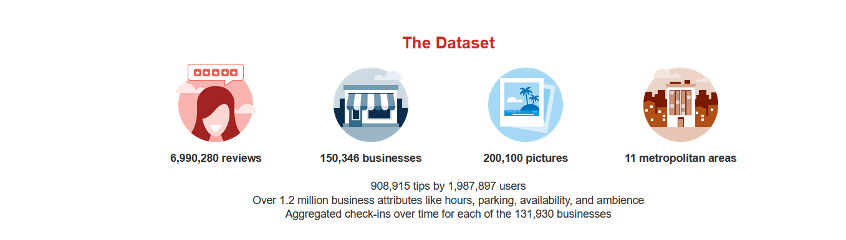
What is Yelp?

Slide 3
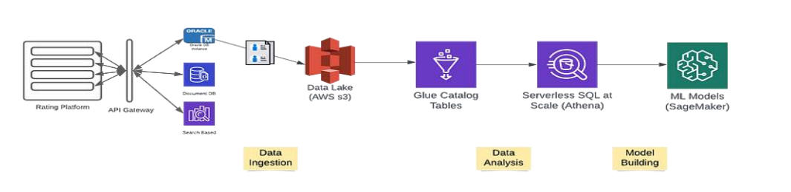
Overview

Slide 4

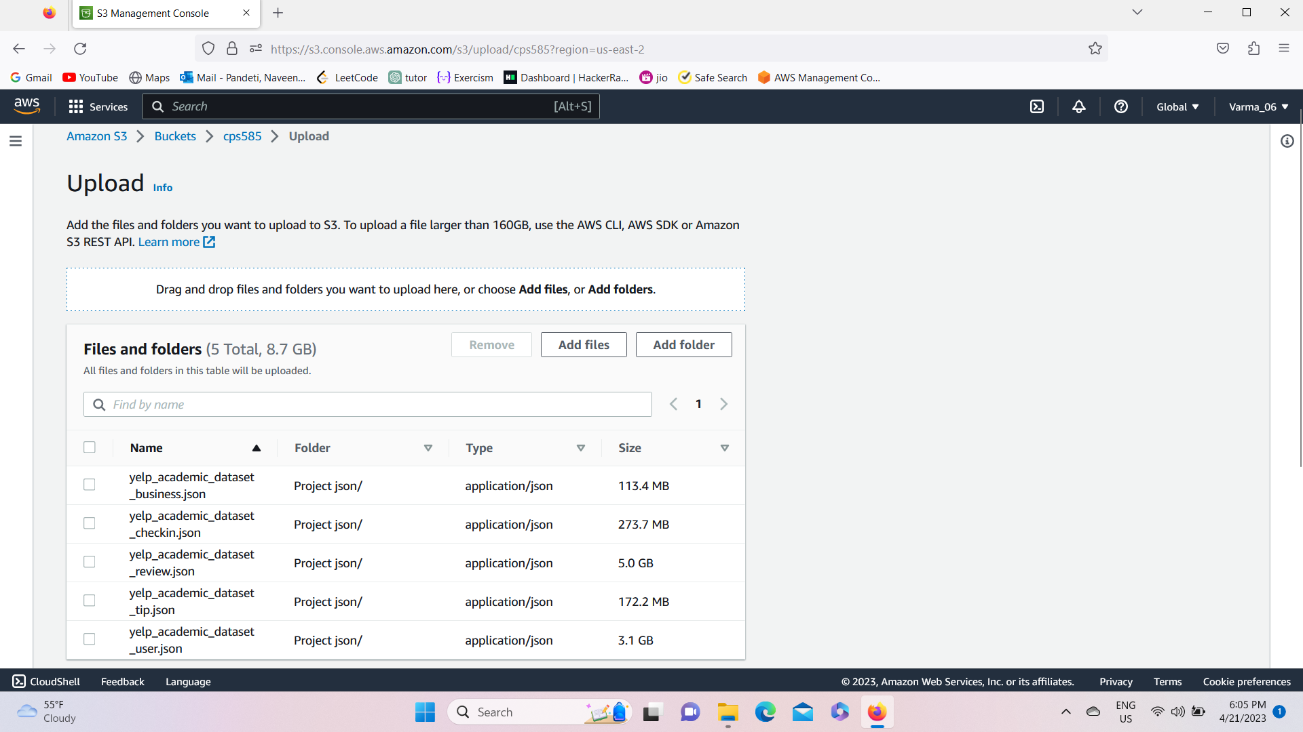
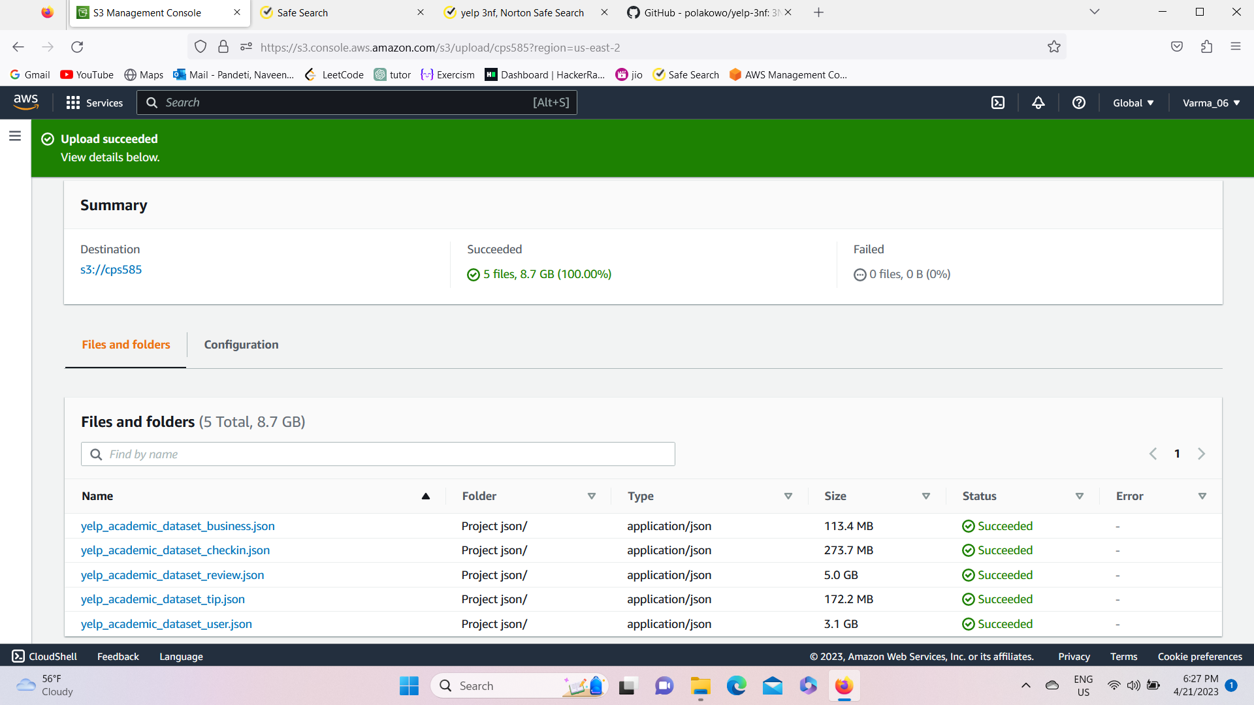
Project Development
Load to S3 (bucket)
We have Suscessfully Created S3 bucket and loaded the JSON files in to it , that processes them, and stores their normalized and enriched versions back into S3 in Parquet format. After this, Redshift takes over and copies the tables into a DWH.
Here, All three datasets reside in a Amazon S3 bucket, which is the easiest and safest option to store and retrieve any amount of data at any time from any other AWS service.

Slide 5
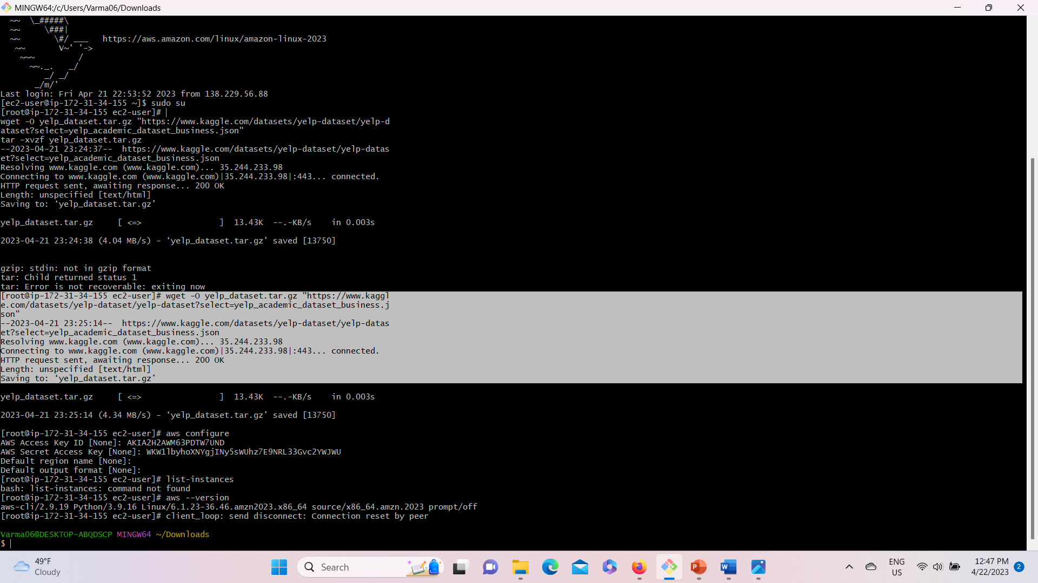
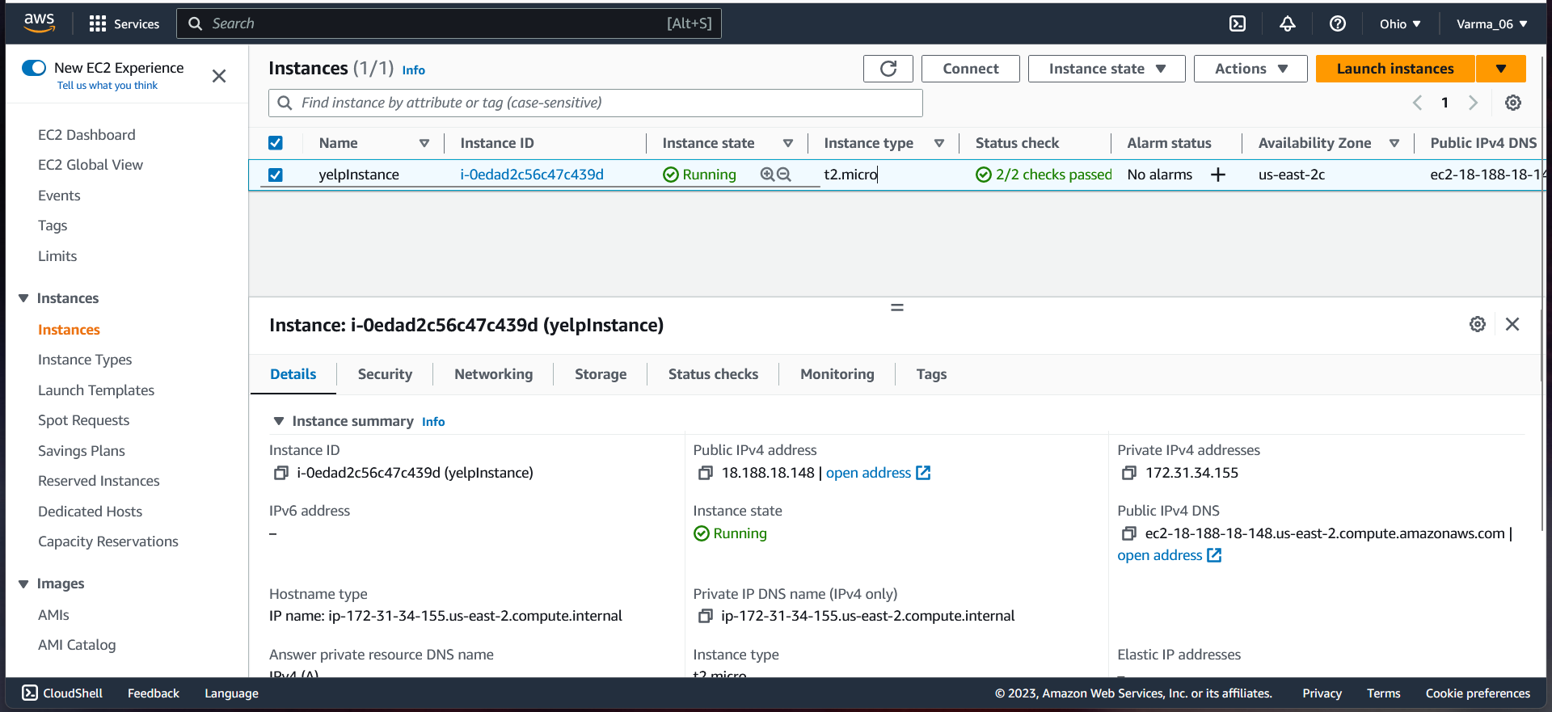



Creating a linux instance(VM)
Created a EC2 Linux instance and connected to the instance through the terminal called Gitbash. As it is a linux machine the ssh port 22 should be enabled in the security group of that instance.
Uploaded all the JSON files to the linux instance through wget command. All the files are successfully uploaded to the instance as shown in the above screenshot.
Next we have created an IAM user and in that we have created a group with s3 full access permisions so that we can easily configure the data from S3 bucket using EC2 instance .

Slide 6
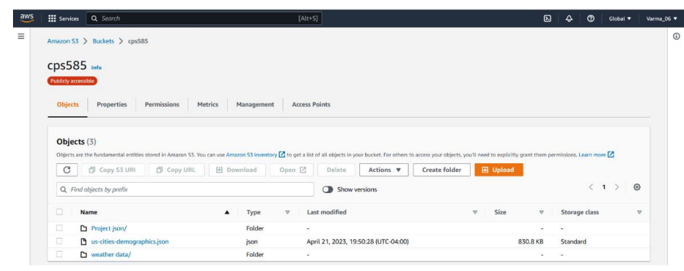
Adding few more datasets(JSON,CSV)
NXT, we have also Downloaded the JSON file from U.S. City Demographic Data and Uploaded it to a separate folder in our S3 bucket.
Along with that we have also downloaded the whole dataset from Historical Hourly Weather Data 2012-2017 Unzipped and uploaded city_attributes.csv, temperature.csv, and weather_description.csv files to a separate folder (weather_dataset) in our S3 bucket.

Slide 7
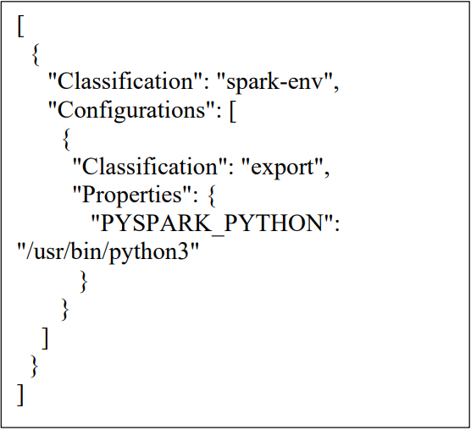
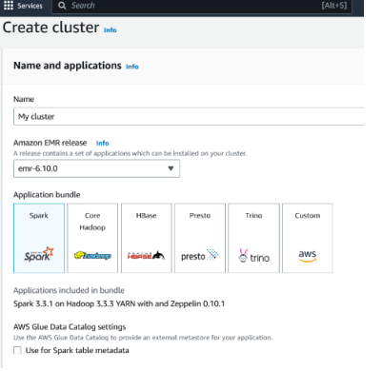
Amazon EMR Cluster
To Configure and create our EMR cluster. We have managed to advanced options, and enabled Apache Spark, Livy and AWS Glue Data Catalog for Spark.
To make python default here we have to follow this JSON configuration.
To run these we have to Go to EC2 Security Groups, and select master node and enable inbound connections to 8998

Slide 8
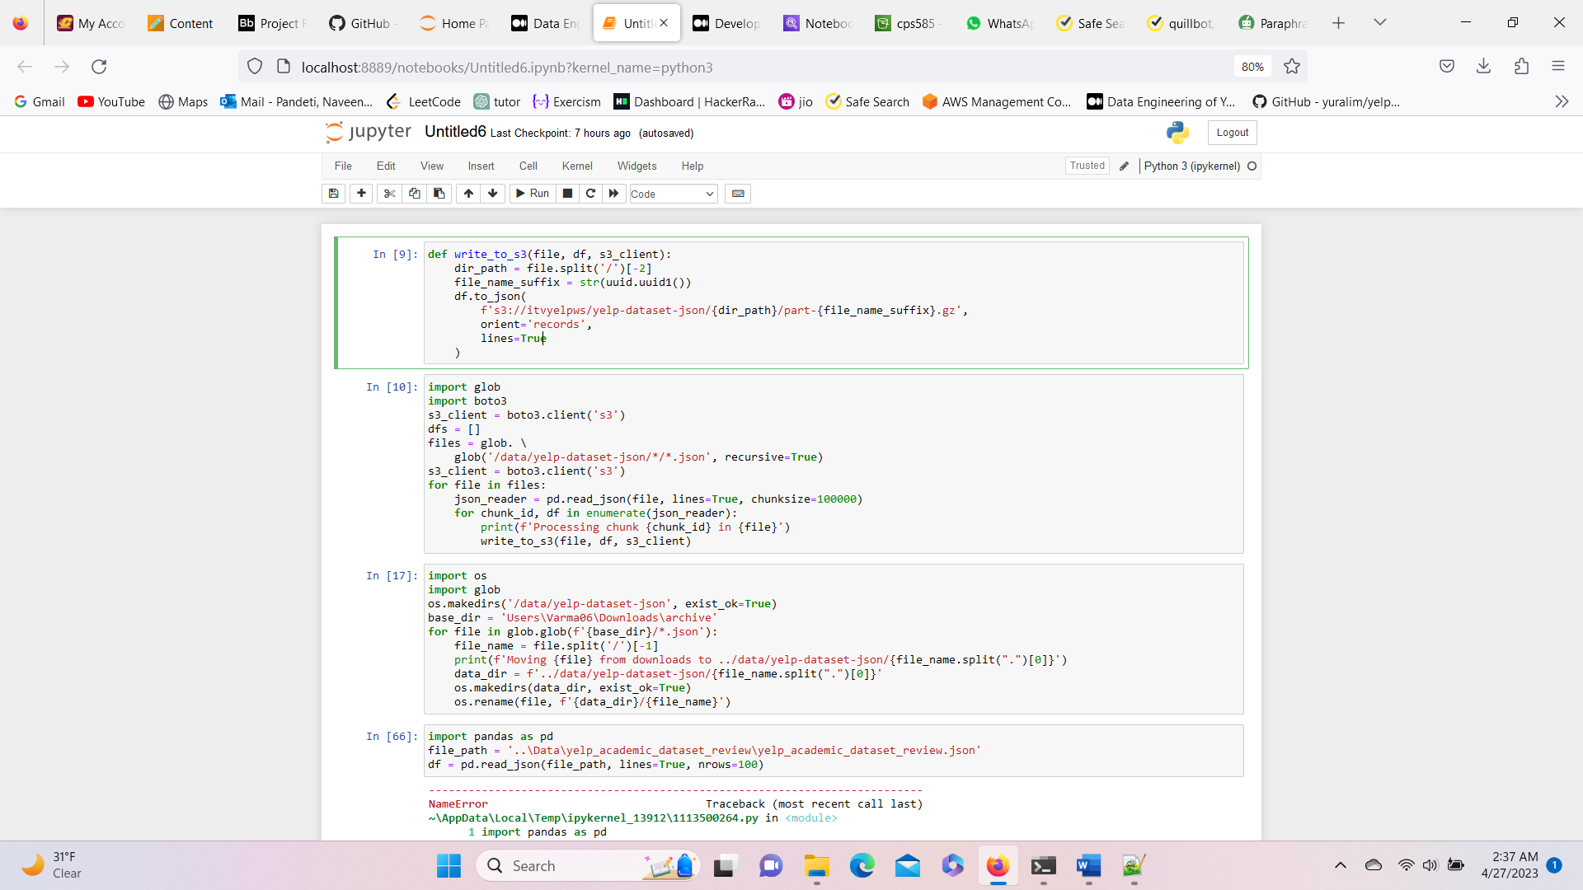
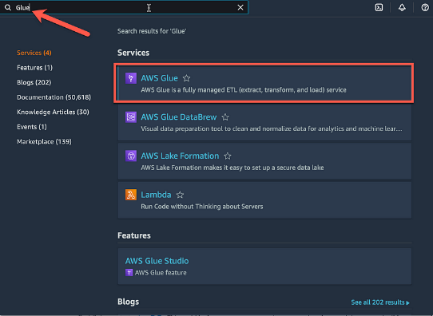
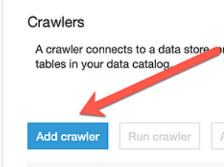
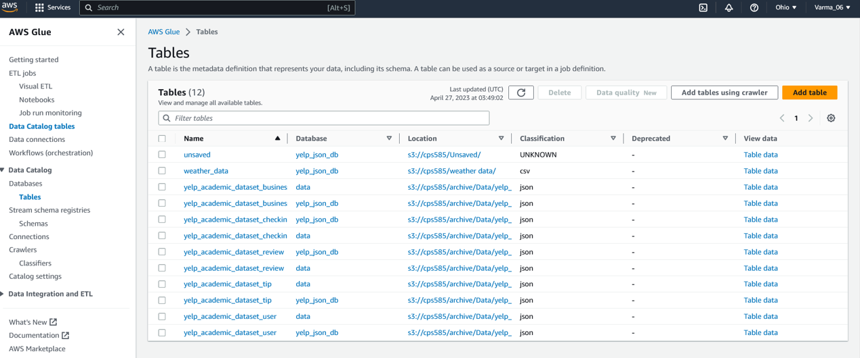
Amazon glue extracting data from S3 bucket
AWS Glue Crawler is a service provided by Amazon Web Services (AWS) that automatically discovers and extracts metadata from various data sources such as Amazon S3, JDBC databases, and other cloud-based or on-premises data stores.
AWS--→AMAZON GLUE→CRAWLER CREATION→allow all permissions and config→add path from S3->CREATE/BROWSE DATABASE->RUN CONFIGURATIONS→output

Slide 9
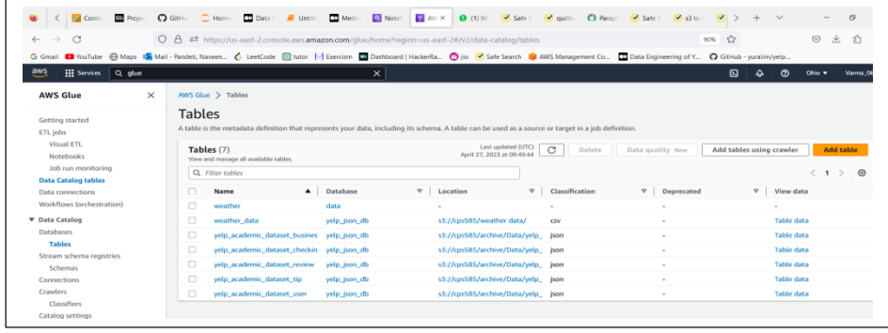
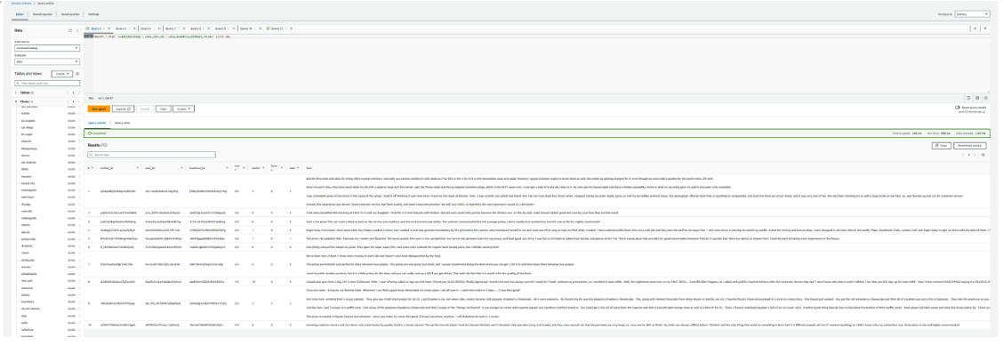
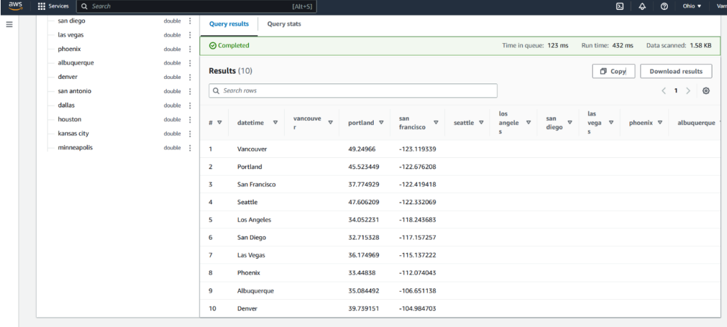
Transform – via Amazon Athena
SELECT * FROM "AwsDataCatalog"."yelp_json_db"."weather_data" limit 10
SELECT * FROM "AwsDataCatalog"."yelp_json_db"."yelp_academic_dataset_review" limit 10
SELECT * FROM "AwsDataCatalog"."yelp_json_db"."yelp_academic_dataset_business" limit 10; SELECT * FROM "AwsDataCatalog"."yelp_json_db"."yelp_academic_dataset_checkin" limit 10; SELECT * FROM "AwsDataCatalog"."yelp_json_db"."yelp_academic_dataset_tip" limit 10; SELECT * FROM "AwsDataCatalog"."yelp_json_db"."yelp_academic_dataset_user" limit 10

Slide 10
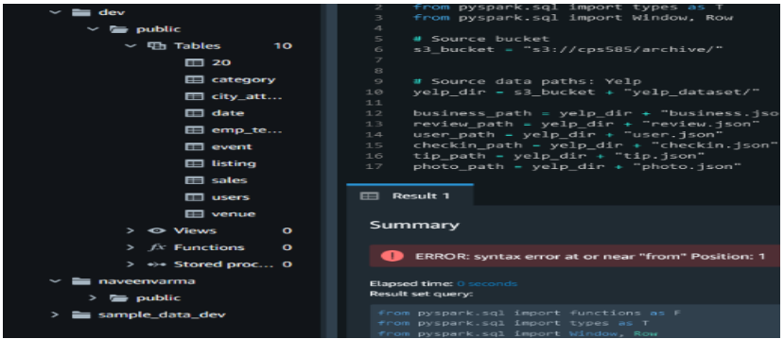
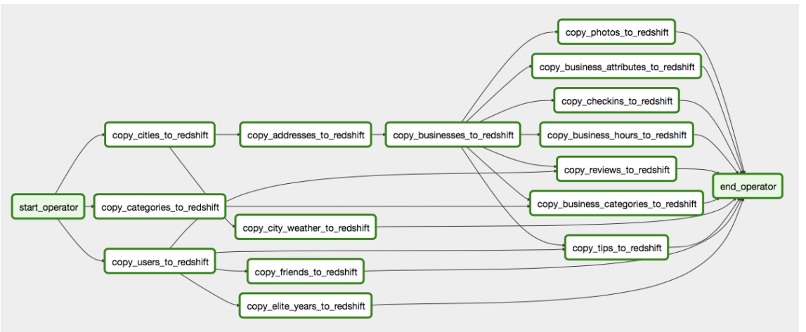
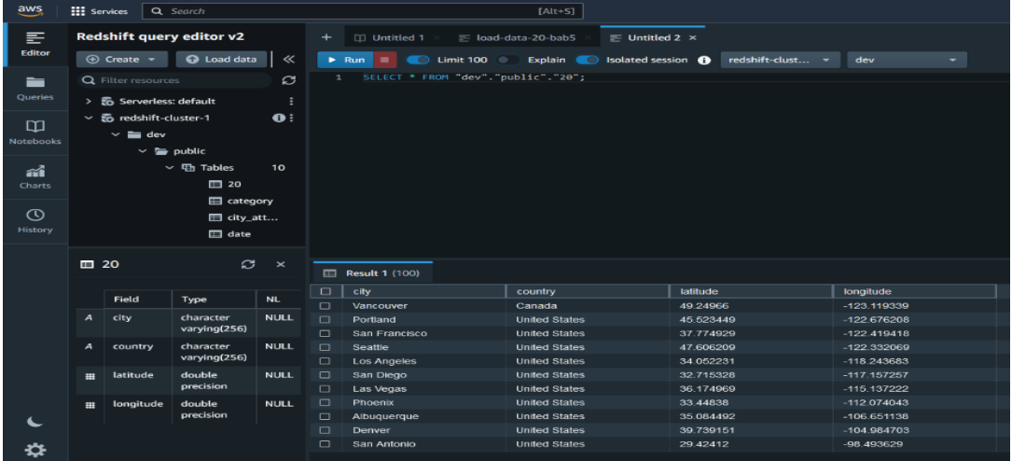
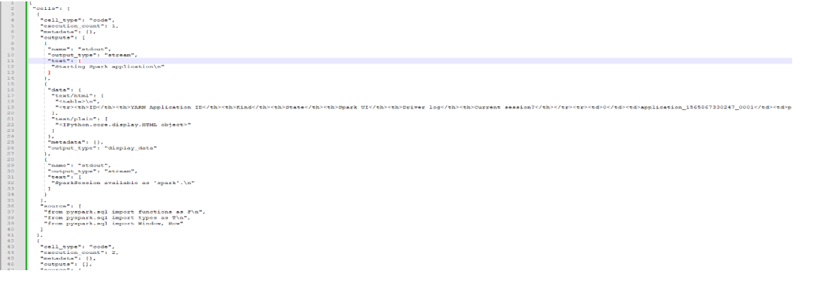
Amazon Redshift

Slide 11
Challenges :
#1 : While Loading large volumes of data into Redshift I felt like it might be time-consuming and may require tuning of the Redshift cluster to optimize performance.
#2 : When we are Transforming the data from its original format to 3NF can be challenging, especially when dealing with nested data structures. It requires a thorough understanding of the schema and a good knowledge of data processing tools like Spark.
#3: We have tried loading data into amazon sagemaker but It took more time and configuring data was complex.
#4:Got more errors in Amazon redshift

Slide 12
Conclusion:
Overall, Yelp's data infrastructure using S3, Redshift, Glue, and Athena provides a highly scalable, flexible, and cost-effective solution for managing and analysing large volumes of data.
By using a 3NF data model, Yelp ensures that its data is organized and structured in a way that maximizes data integrity and minimizes redundancy.
This enables Yelp to extract valuable insights from its data, which it can use to improve its services and enhance the user experience.
Future Scope:
Implementing AIRFLOW DAGS for data security
Thank you

